Slide 1

PA 604
Sampling
Professor Burrel Vann Jr

Slide 2

Population
All units of analysis (cases, individuals, groups, objects, events) that exist for a specific topic
Sample
A subset of the units of analysis in the population

Slide 3


Why do we sample?
Why not just take the population?

Slide 4
Why do we sample?
POPULATION REASONS
Time consuming to observe/collect data
Expensive
Population changes over time
Generalizability

Slide 5
Sampling
The exact process of how a researcher selects units for their sample

Slide 6

TWO TYPES OF SAMPLING METHODS
NON-PROBABILITY
PROBABILITY
Selecting units based on convenience to researcher, not based on probability theory
Selecting units by relying on probability theory

Slide 7
Which method do we use, and when?

Slide 8
USES FOR EACH SAMPLING METHOD
NON-PROBABILITY
PROBABILITY
When researcher wants a non-representative sample (one that is not representative of the population)
Non-generalizable
Cannot provide exact estimates of a unit's likelihood of inclusion/exclusion
When researcher wants a sample that is representative of the population
Generalizable
Can provide exact estimates of a unit's likelihood of inclusion/exclusion
Notes:
prob sampling
The quality of a sample of having the same distribution of characteristics as the population from which it was selected.
minimizes bias:
not biased b/c it looks like population
If population has 23% of white, married, pregnant women… then your sample should have “close to” 23% of white, married, pregnant, women.
But if race, marital status, fertility, or gender are not important for your study, you may not need to worry about getting a close enough sample to match the population proportions of this very specific group.

Slide 9

Generalizability
making claims about the population based on the sample
Representativeness
Sample has the same distribution of characteristics as the population from which it was selected.
A sample is representative of the population if all units within the population have an equal chance of being selected for the sample. Can make generalizable claims.
Bias
Sample bias/error is minimized if it looks like population. Claims can be generalizable to population

Slide 10

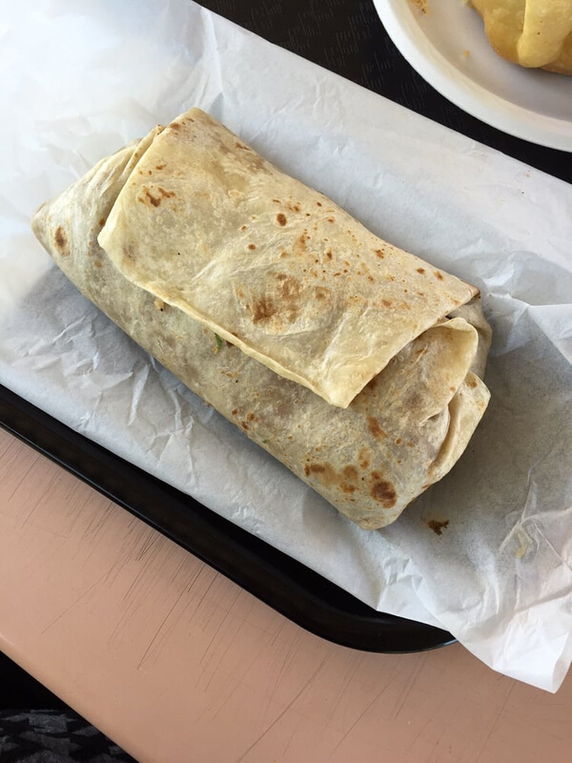
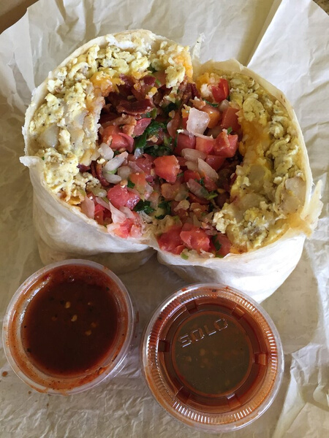
POPULATION
SAMPLE
Non-Probability
Non-representative of population
Probability
Representative of population
Notes:
we have to figure out what kind of sample (bite) we want to take:
Just a convenience bite (ala non-prob) or a probability sample that represents everything in the entire burrito
non prob bite will only be tortilla... is that representative of the entire burrito?
prob bite will be a nice cross-section, small bite with a little bit of everything that is inside burrito

Slide 11
USES FOR EACH SAMPLING METHOD
NON-PROBABILITY
PROBABILITY
Qualitative Research
Quantitative Research

Slide 12
USES FOR EACH SAMPLING METHOD
NON-PROBABILITY
PROBABILITY
Understanding "Meaning"
Investigating "Experiences"
Finding Statistical Associations
Basis of Inferential Statistics (Generalizability to Population)
Notes:
prob: Can provide exact estimates of a unit's likelihood of inclusion/exclusion
If researchers want statistical descriptions (not qualitative ones) and want a sample that is guaranteed to be representative of the larger population, they turn to probability sampling.
If all members of a population were identical in all respects there would be no need for careful sampling procedures
A sample of individuals from a population must contain the same variations that exist in the population

Slide 13

NON-PROBABILITY
Available subjects
Snowball sampling
Purposive sampling
Quota sampling
Specific Sampling Methods by Type
PROBABILITY
Simple Random Sampling
Systematic Sampling
Stratified Sampling
... etc

Slide 14
Non-Probability Sampling
best for non-generalizable research
often used in qualitative research

Slide 15
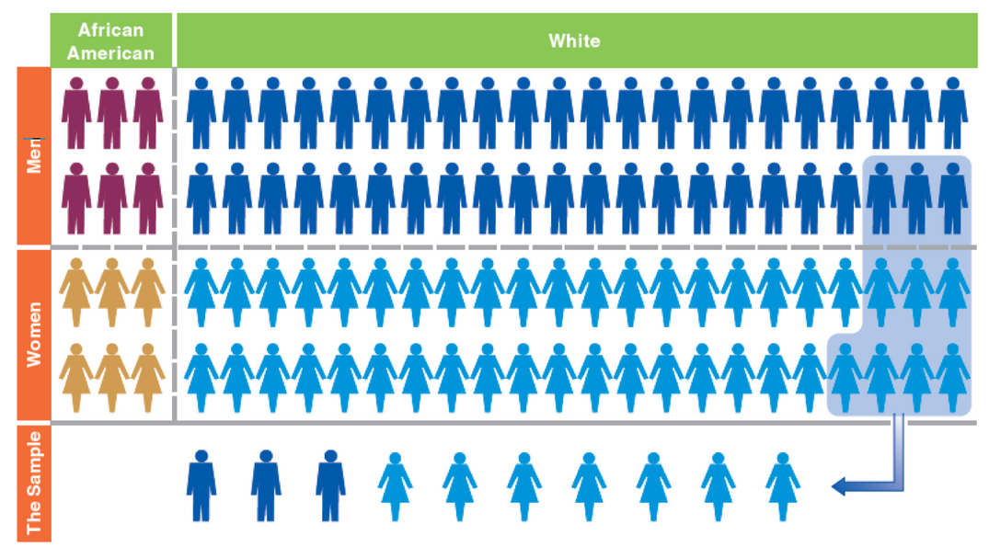
AVAILABLE SUBJECTS
units selected based on convenience/proximity to researcher
Notes:
Availability is extremely risky. Does not allow for control over the representativeness of the sample. Only useful if the researcher wants to generalize only to their sample (which is in effect the population) of people, who passed a street corner, in LA, at 3pm, on a Wednesday, in May. Do not generalize beyond the sample.

Slide 16
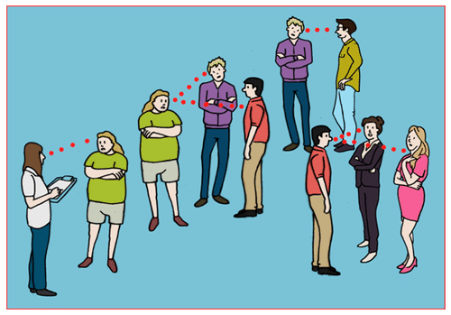
SNOWBALL SAMPLING
Each person interviewed is asked to suggest additional people for interviewing.
Notes:
Snowball sampling – person interviewed is asked to refer or suggest another potential respondent who shares the attributes important to the study. In a study of homelessness, it’s difficult to reach an entire or even subset of the population. As such, you interview one homeless person and ask him/her to suggest another, then the following suggests another… and so on, like a snowball that accumulates snow, you accumulate respondents.

Slide 17
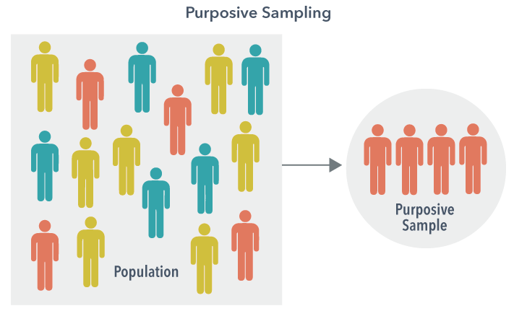
PURPOSIVE SAMPLING
Units selected based on researcher’s judgment about whether or not subjects are useful for findings/results.
Notes:
Purposive – selecting SPECIFIC cases for the purpose of the study – you want to study student movement leadership but can’t sample all leaders so you select enough leaders to reach a general conclusion about student movement leadership. This type should also not be generalized and should count as exploratory research.

Slide 18
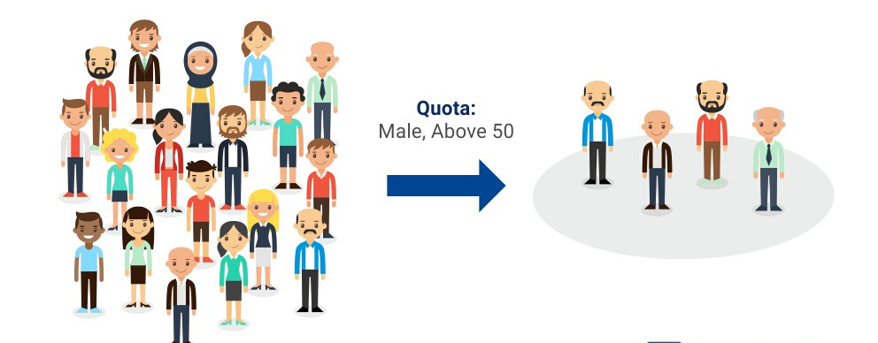
QUOTA SAMPLING
Units selected based on pre-specified characteristics. Sample will have the same distribution of characteristics as the population
Notes:
Quota sampling – starts with characteristics of target population (proportions of various social groups), [and you decide on a sample size, and collect exact proportions of your sample to match the proportions found in the target population… or,] you collect data for an undetermined (but large) number of people, taking down their characteristics and matching them to a particular category of characteristics. Whatever characteristics they match, you weight their responses accordingly (so if blacks men are 2% of the population and you have 2 black men in your sample, you give their responses a weight of 2% for the total sample). Must have accurate population information for the data to make sense.
Say you want to interview various members of a student group but ensure that you have representation by all types of members… quota sampling is best. However, you should not use quota sampling if you want to do statistical analysis, since your sample is not randomly drawn as expected by probability… you’re still biased in the way you approach respondents (you’re looking for specific types of people to fit into categories and then weighting if you get more or less of a particular category). All nonprobability methods should be used for qualitative work, not quantitative.

Slide 19
Things to Consider
Selecting Informants
Someone who is well versed in the topic (e.g. specific group) you wish to study, who is willing to tell you what they know, who can talk directly about the group/people and provide information, or who can introduce you to the group/people.
Gaining Entrée (Entry/Access to Group or Topic)
Meeting the gatekeepers (informants) of the group/topic and developing personal relationships with them, which can serve as a springboard for them trusting you as a researcher and (perhaps) make them more likely to participate or introduce you to other potential participants

Slide 20
Probability Sampling
best for generalizable, representative research (making statements about population
necessary for quantitative research
can be used for qualitative research
Notes:
can make statements about the probability any given case is included/excluded.

Slide 21
How to we ensure representativeness and generalizability?
How to we abide by logic of probability theory?

Slide 22
Probability Sampling Requires
Random Selection
Each unit within the population has an equal chance of selection for the sample. They will be randomly selected from the population
Sampling Frame
A list of all units in a population. Used to select which units will be in the sample. Note: Think about the structure of the sampling frame (randomize it).
All probability sampling needs a sampling frame
Notes:
So if the population is current students at university X, the sampling frame is a list of all students who currently go to university X.
U of Hawaii wanted to study students… and were stratified by class (fr, so, jr, sr), and thereafter stratified by ID numbers (which were social security numbers, which begin differently for each state)… therefore the researchers implicitly also stratified by geographic region.
As such, ordered lists can be more useful than unordered ones.
Read the example on sampling university students on page 230 in the old book.
Also, note that after you begin your project it’s okay to modify your sampling plan based on the feasibility of the design (see pg 230-231 on probably the only reason to modify your design).

Slide 23
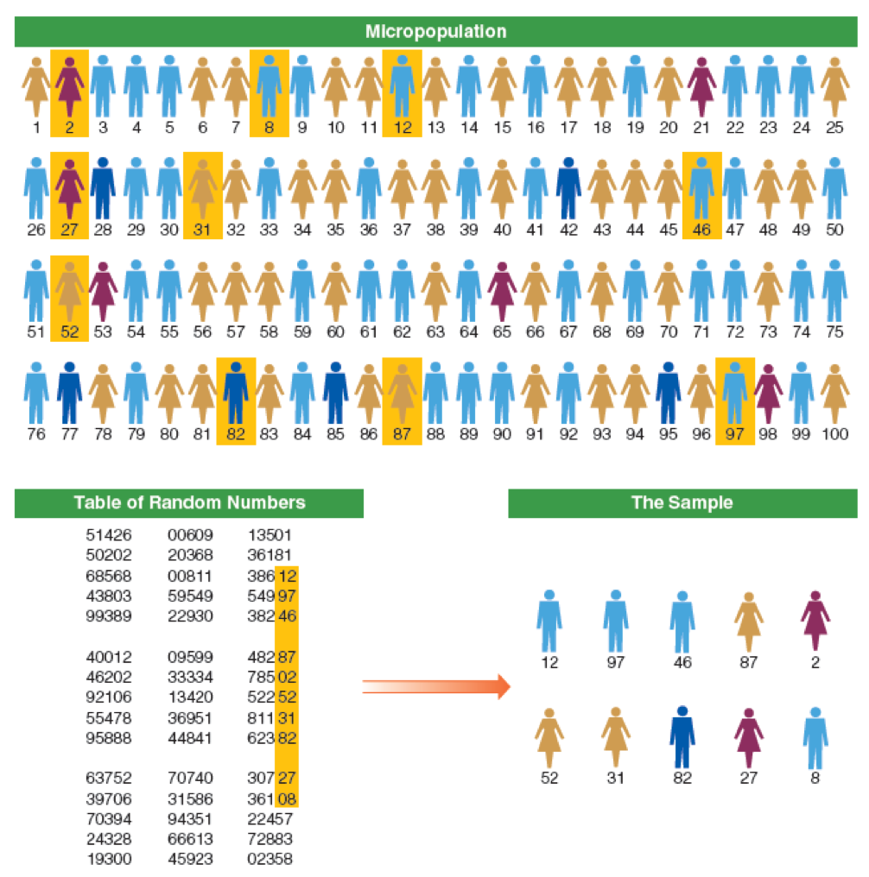
SIMPLE RANDOM SAMPLING
Units are assigned numbers. A set of random numbers is generated and the units having those numbers are included in the sample.

Slide 24
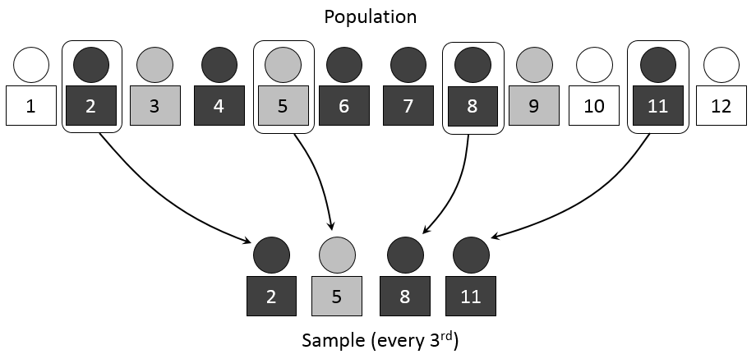
SYSTEMATIC SAMPLING
Every kth unit in a list is selected for inclusion in the sample.
Notes:
You should select the first element at random to eliminate bias… and to be truly systematic and random, the list may need to be randomly rearranged.

Slide 25
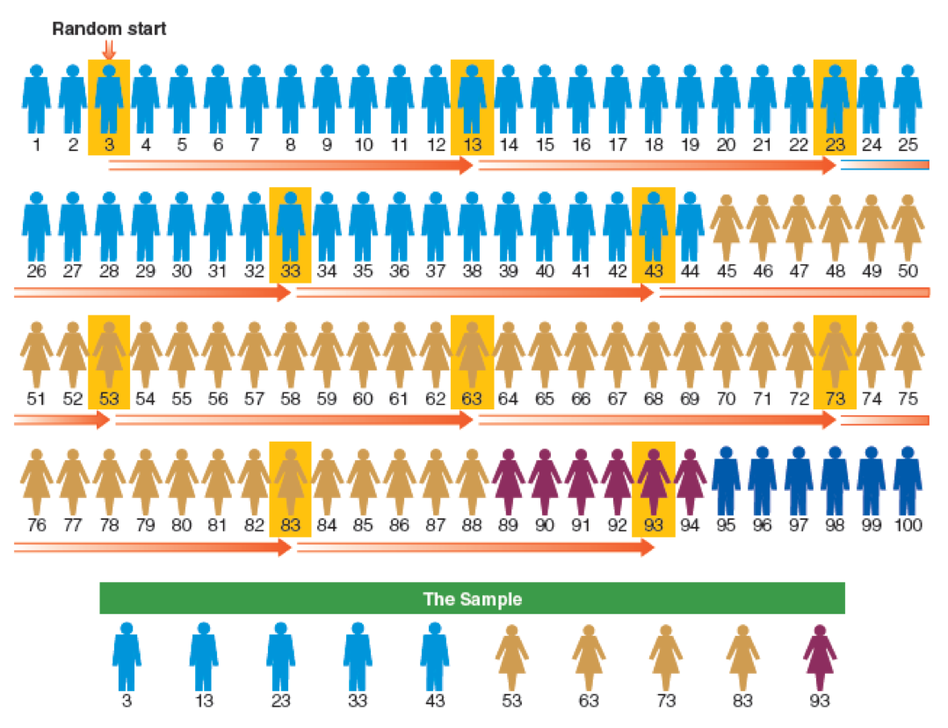
STRATIFIED SAMPLING
Grouping units on sampling frame into homogenous groups (strata). Conduct systematic sampling on the entire list.
Notes:
To get a stratified random sample of college students, you would first get the entire list, but then organize the list by subgroups… freshmen listed first, then soph… all the way up to seniors. By doing so, sampling error based on class size is reduced to zero.

